Slide 1

Prepared by Logical Operators
for COSC 3F00
February 6th, 2014

Slide 2
Team Introductions

Slide 3
Using Agile Principles
Our highest priority is to satisfy the customer through early and continuous delivery of valuable software
Working software is the primary measure of progress
At regular intervals the team reflects on how to become more effective then tunes and adjusts its behavior accordingly

Slide 4
Communication
reviewed the rules and game play of chinese checkers
brainstormed and built a list of 38 high level use cases

Slide 5
Feature Set | Description | Order | Target Iteration
Game | create a game | 1 | 1
Game | specify game settings (# of players, player color) | 2 | 1
Game | show hotseat game board | 3 | 1
Game | peg animation | 4 | 2
Game | hotseat (offline, no AI) | 5 | 2
Game | close game | 6 | 2
Account | acheivements
Account | anonymous accounts
Account | create an account
Account | edit/delete account

Slide 6
Feature Set | Description | Order | Target Iteration
Account | friends list
Account | game history, rank, etc.
Account | leaderboards/ranking
Account | login with Facebook
Account | logout
Account | message inbox
Account | password reset (via android ... if poss.)
Account | profile page
Admin | admin screen for system analytics
Admin | EULA + COPPA compliance

Slide 7
Feature Set | Description | Order | Target Iteration
Game | 1st-6th place get points
Game | AI takes over when user forfeit
Game | demo mode (to watch AI)
Game | friend request
Game | game playback
Game | in-game chat
Game | multiple games
Game | pegs left to win
Game | play against an AI
Game | player label
Game | set music/fx volume

Slide 8
Feature Set | Description | Order | Target Iteration
Game | timed games
Game | timeless (long) games
Game | toggle show possible moves
Game | turn notification
Help | "help" section
Web | app webpage
 | game lobby

Slide 9
Planning
Calculated 528 total budgeted hours
Split budget into time-boxed iterations
Prioritized the list of use cases
Pulled highest priority use cases into first iteration
Decided on tools to use

Slide 10
Team Capacity Calculations
Release Level Plan |  |  | Iteration Level Plan
Start | 9-Jan |  | Iteration # | # Weeks | Hours
Finish | 27-Mar |  | 1st iteration | 4 | 192
Last Day of Class | 4-Apr |  | 2nd iteration | 3 | 144
 |  |  | 3rd iteration | 3 | 144
Work Days | 77 |  | 4th iteration | 1 | 48
Work Weeks | 11
# of People | 8 |  | Total Hours |  | 528
Hours/Week/Person | 6
Total Hours | 528

Slide 11
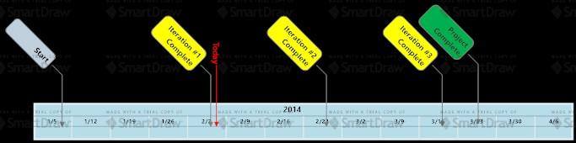
Project Timeline

Slide 12



Tools
Google Drive
GitHub (https://github.com/kubasub/chinese-checkers)
Android Studio (http://developer.android.com/sdk/installing/studio.html)
SourceTree (http://www.sourcetreeapp.com)

Slide 13
More Tools
Paint.NET
Corel PaintShop Photo Pro X3
Adobe Photoshop CS5.1
Pen and paper

Slide 14
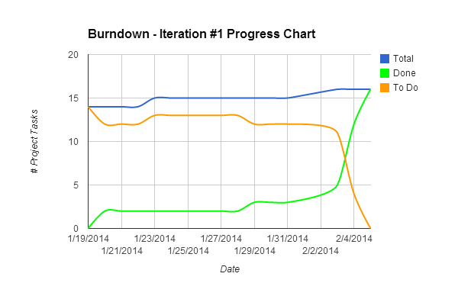

Slide 15
Design
Use Cases
User Interface mockups
Data Flow and UML
Test plan

Slide 16
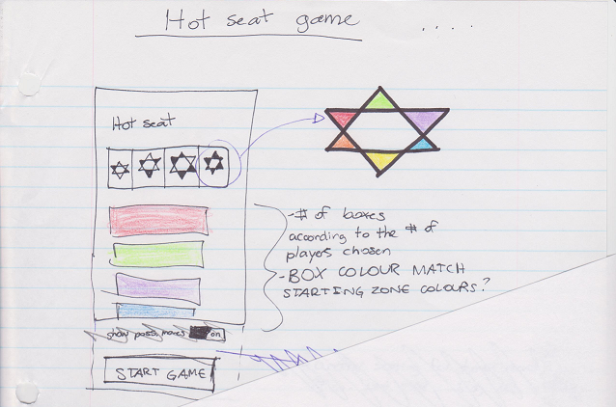

Slide 17
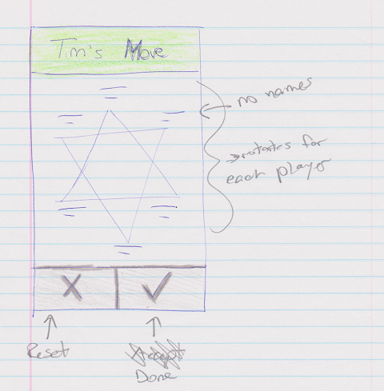

Slide 18
Construction
Code and unit test
Integration test
Performance test
Stress test
Usability test
Acceptance test

Slide 19
Demonstration

Slide 20
Feedback?
Q&A

Slide 21
Thank you

